Slide 1
Lecture 11 Advertising + Airline Revenue Management

Slide 2

Advertising in Social Network

Slide 3

Advertising in Social Network
Who should I target?

Slide 4
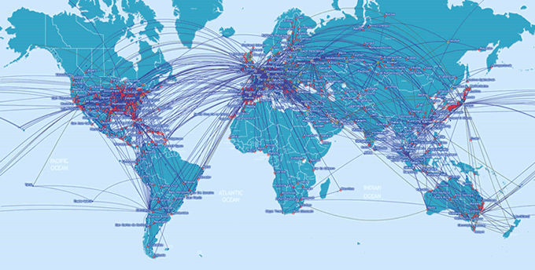
Network Revenue Management

